Slide 1
Lab 2 Data Manipulation and Descriptive Stats in R
Sean Potter

Slide 2
Today’s Agenda:
Sorting datasets
Subsetting datasets
Recoding variables
Descriptive stats with “describe” function
Checking normality
Sampling distribution exercise
Assignment & Questions

Slide 3
What to do before starting analyses
View your dataset to check for errors
Recode variables as necessary
Obtain descriptive statistics
Helps give you quick idea of what’s going on with data
Another way to check for errors

Slide 4
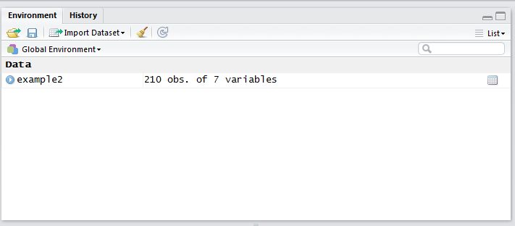
Viewing Dataset
Download and import Example2 dataset into R
Two ways to view dataset
Double-click on the name of dataset under environment tab
Use View command on name of dataset

Slide 5
Sorting Dataset
Can sort by individual variable by clicking on it when viewing dataset
Can use order function to sort by multiple variables

Slide 6
Subsetting data
Often want to look at subsets of cases for analyses
Remove observations for various reasons (i.e., failing attention checks, etc.)
Keep all females (exclude males) for an analysis
Requires use of subset function, has three main elements
Name of object you are subsetting
Conditional statements you are subsetting with
Vector of variable names from original dataset to keep in new subset
Can use colon “:” to specify range of variables to keep

Slide 7
Recoding Variables
Giving categorical variable responses correct labels
Often coded numerically, want to express what each value means
Example2 data has sex variable where 0 = male, 1 = female
Use factor function to specify variable, its levels, and then labels for each level

Slide 8
Reverse Code Items
Important when dealing with measures that have reverse scored items
One approach is with recode function in “car” package
Specify variable to recode, then provide recode instructions within quotes (“”)
Other approaches out there! Always double-check if scoring works properly

Slide 9
Descriptive Statistics
Will use describe function from psych package
Can use describe on either a whole dataset or individual variable

Slide 10
Descriptive Statistics by Group
Can use describeBy function in psych package
Allows you to produce descriptive stats by group

Slide 11
Exporting Descriptive Stats to Word
Use xtable package
First convert object into xtable format with xtable function
Use print.xtable function to print table as html file
Find html file where your working directory is set
Copy and paste table into word or excel

Slide 12
Checking Normality
Look at skew and kurtosis (done with describe function)
Look at histogram, overlay a line showing it’s distribution
Example qq-plot
Shapiro-Wilks test

Slide 13
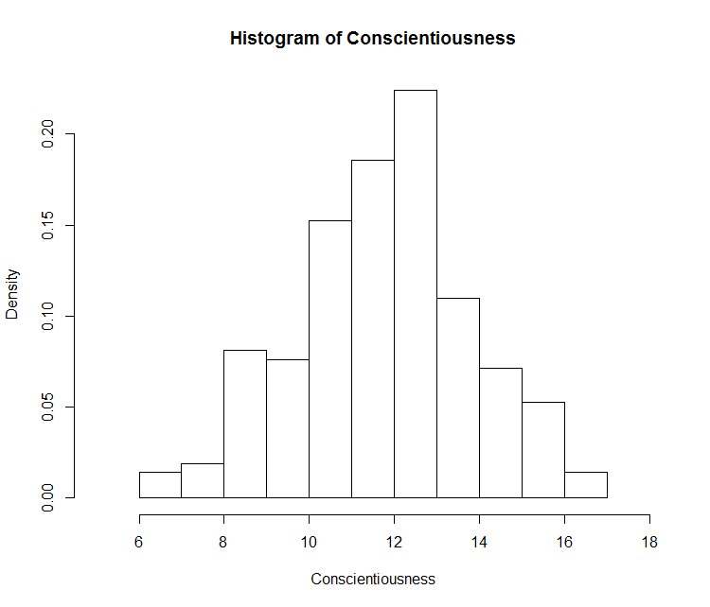
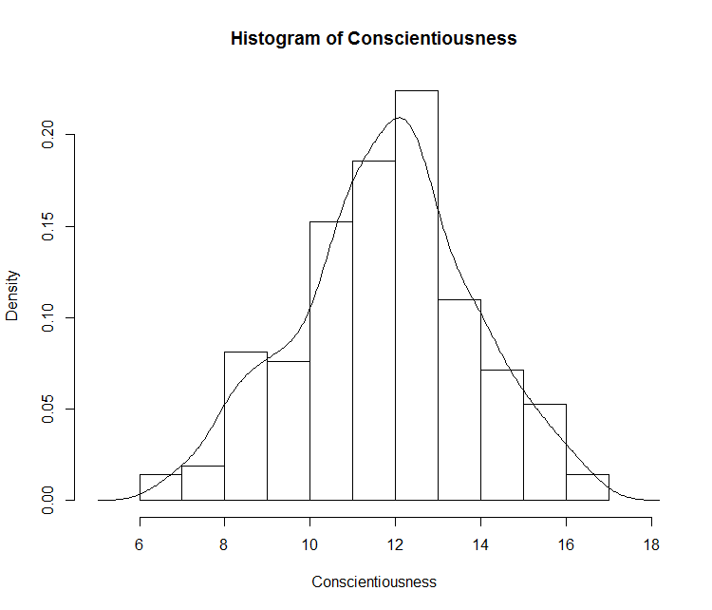
Histogram
First make histogram with hist function
Set freq to FALSE, it will plot probability now instead of counts
Then, use lines to draw the density line over histogram)
Check to see how normally shaped is the histogram
Density line added

Slide 14
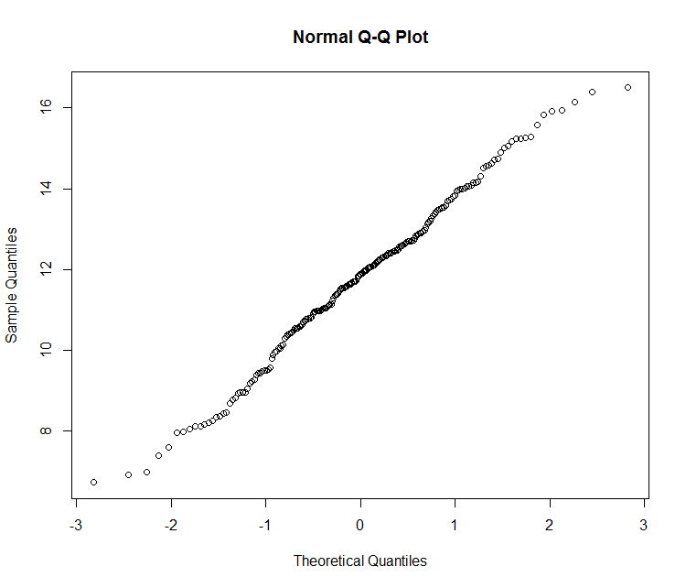
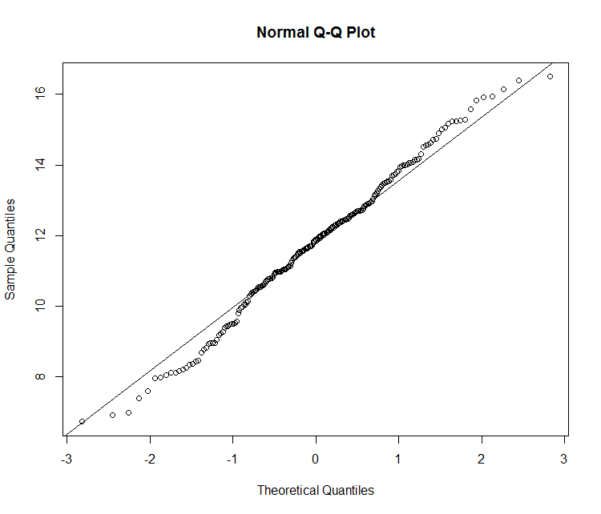
QQ-Plot
Similar procedure as before
Use qqnorm function on variable
Use qqline to then draw line over figure
Check to see how well observations line up along qqline
qqline added

Slide 15
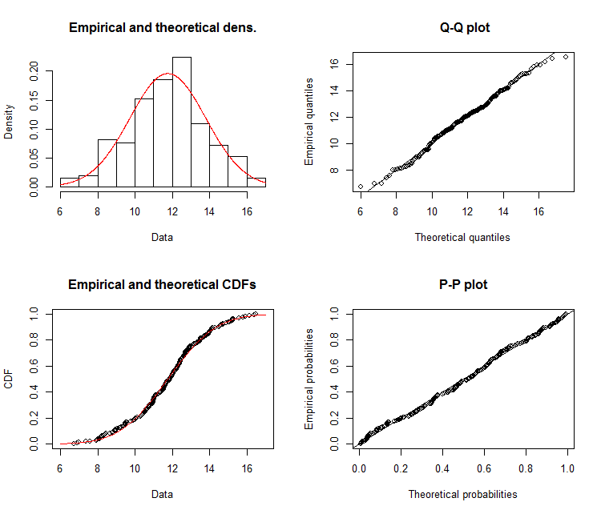
Secondary Approach to Check Normality
Use fitdist from fitdistrplus package
Apply fitdist to variable, use “norm” option
Plot results.
Produces everything, can’t customize figures, plots are small

Slide 16
Shapiro-Wilks Test
Significance test where null assumes data is from normal population
p < .05 suggests data comes from non-normal population
Shouldn’t be only tool you use to judge if data are sufficiently normal
Sample may be too small to detect departure from normality
Sample may be fairly large, slight normality departure would be flagged
Should be examined together with visual plots
Plots help to examine where potential issues if data look non-normal

Slide 17
Sampling Distribution Exercise
R excellent tool for creating statistical simulations
Allows us to better understand principles, aka “what’s going on”
Simulation will allow us to see empirical support for Central Limit Theorem
Going to create a simulation that has five parameters for us to play with
N = number of subjects per sample when resampling
Resampling = number of resamples (keep it set to high value)
src.dist = shape of population distribution
Population either normally-shaped “N”, or has a skewed gamma shape “G”
Pop.mean = the average value in population
Pop.sd = how much variability there is in population

Slide 18
What does the simulation produce?
Output
Mean and SD for both the population and sampling distribution
Two graphs
Distribution of population
Sampling distribution of mean

Slide 19
Let’s play with the parameters!
Change the values of N
Start small (N=1, 2, 5, etc.), then try larger values (N=30,40 100, etc.)
What happens to the sampling distribution as N increases?
Change the values of the population mean and SD
How does these values affect the sampling mean and SD?
Change the shape of the population distribution
What happens to the shape of the sampling distribution?

Slide 20
What does central limit theorem tell us?
What is the mean of sampling distribution?
What is SD of sampling distribution?
How does N affect the shape of the sampling distribution?

